Slide 1
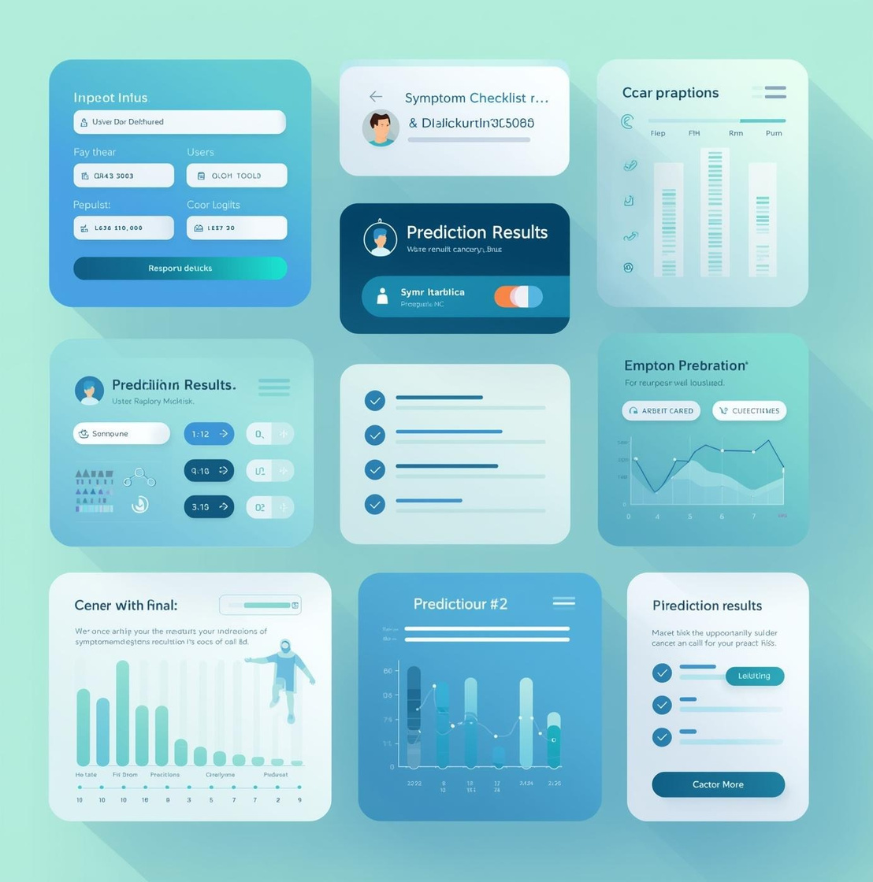
Cancer Risk Predictor
Presented by ABHINAYA RD and ANDRYAN DURAI JEBIN

Slide 2
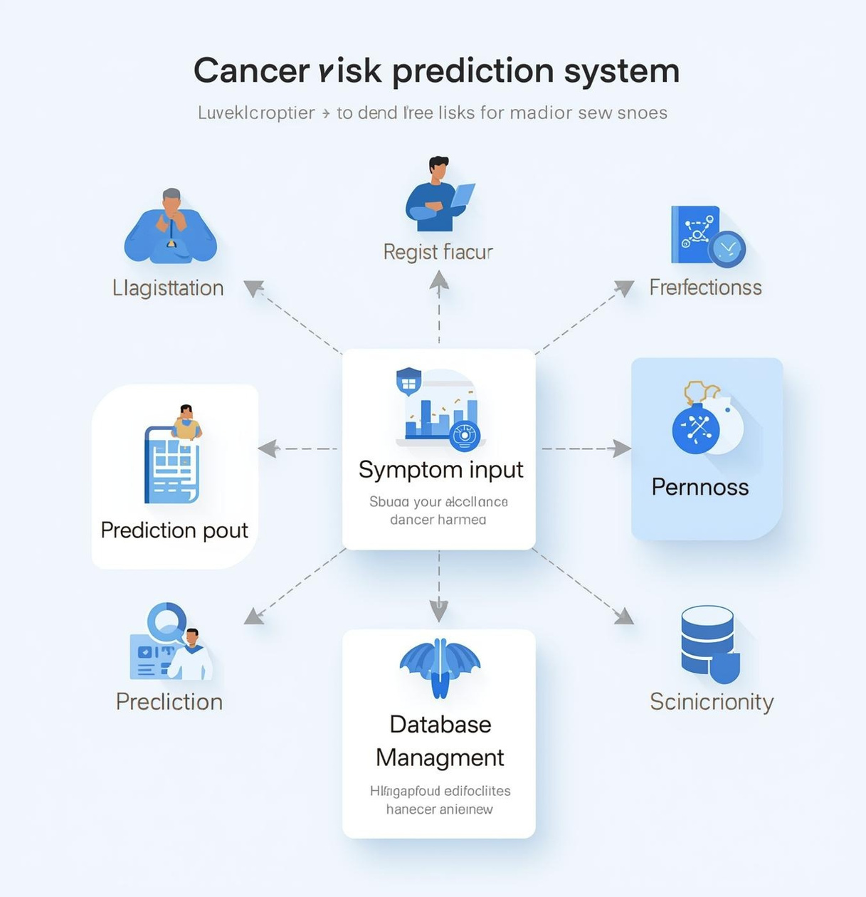
Introduction and Overview
Cancer Risk Predictor System
Patient Registration
User Login
Patient Registration
Data Logs
The Cancer Risk Predictor project aims to develop an innovative tool for early cancer risk assessment. This presentation outlines the modular architecture and user workflow, highlighting the significance of digital health tools in cancer risk prediction and management.
Data Analysis
Data Reports
Data Synchronization
Predicted Output

Slide 3
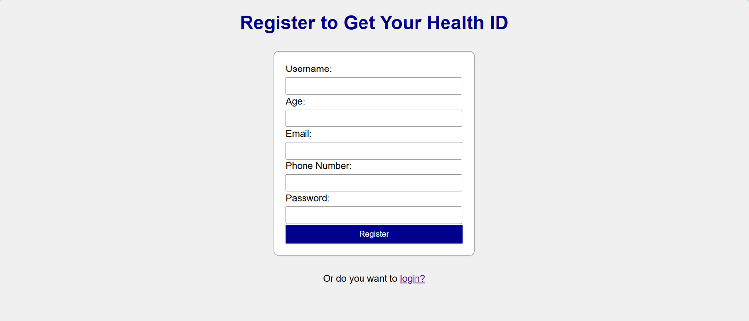
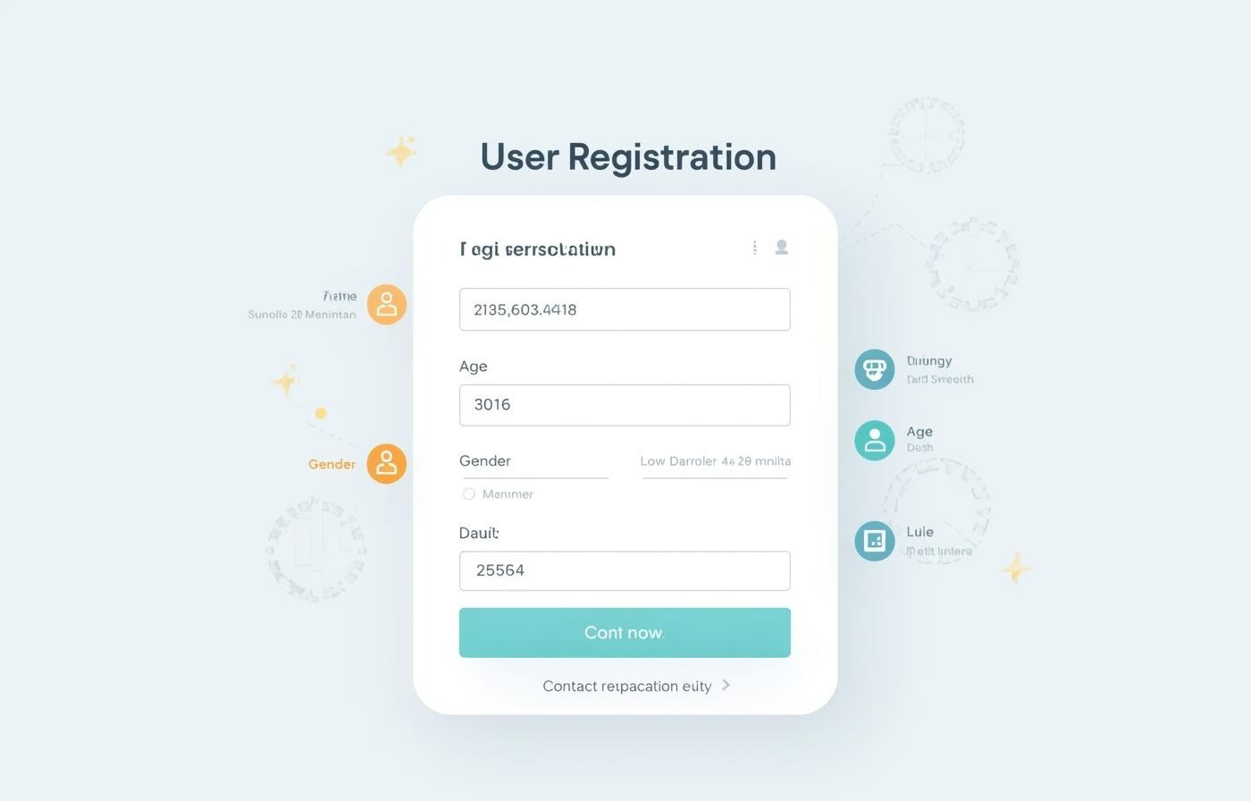
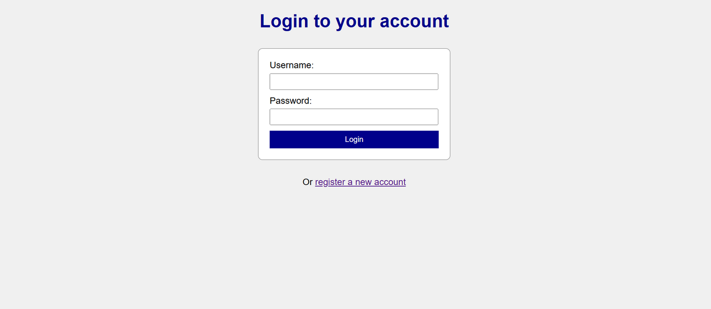
User Registration
Capturing Essential User Details Securely
The registration and login page is designed to safeguard user information while ensuring a smooth experience for cancer risk assessment.

Slide 4



Secure User Login Functionality
01
03
02
Access
Users can securely access their accounts anytime.
Privacy
Userdata is protected
Verification
Multi-factor authentication enhances user account security.
through robust security measures.

Slide 5
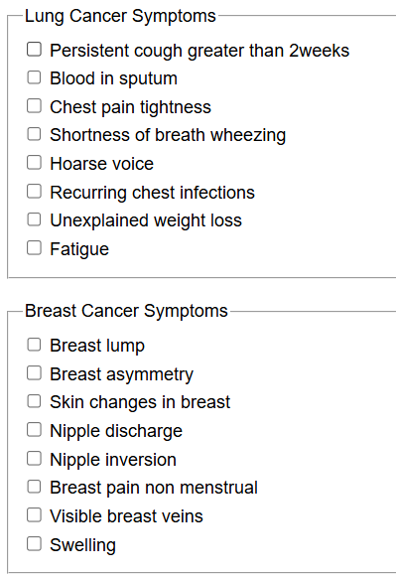
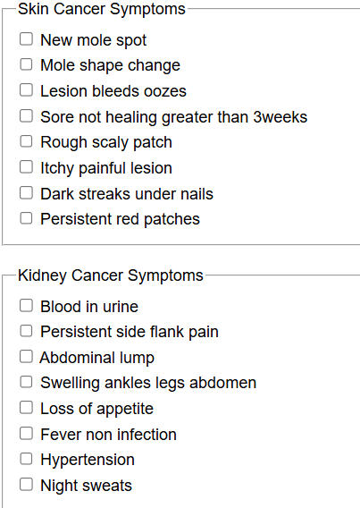
Symptom Input
Collecting Data for Cancer Risk Assessment
This portion, users can select or enter the symptoms they are experiencing from a predefined list categorized by cancer types

Slide 6



Lung Cancer Symptom Input Overview
01
03
02
Cough
Persistent cough can indicate lung issues.
Chest Pain
Discomfort in the chest should be evaluated.
Breathlessness
Difficultyin breathing may
signal lung problems.

Slide 7
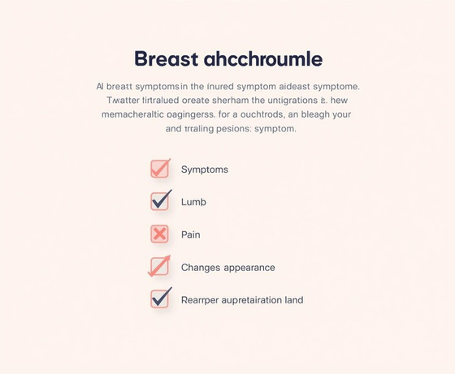

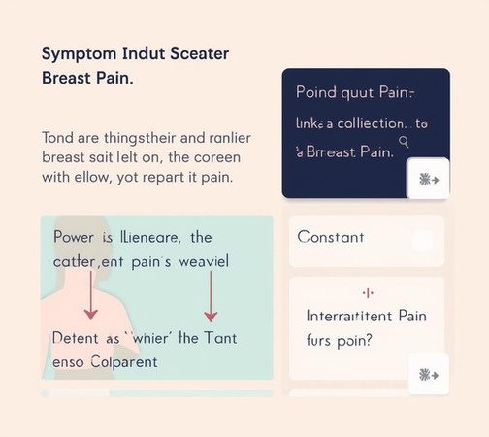
Breast Cancer Symptom Input Overview
01
03
02
Lump
Indication of any new growth in the breast.
Changes
Evaluation of any visible alterations in the breast.
Pain
Assessment of any discomfort experienced by the user.

Slide 8
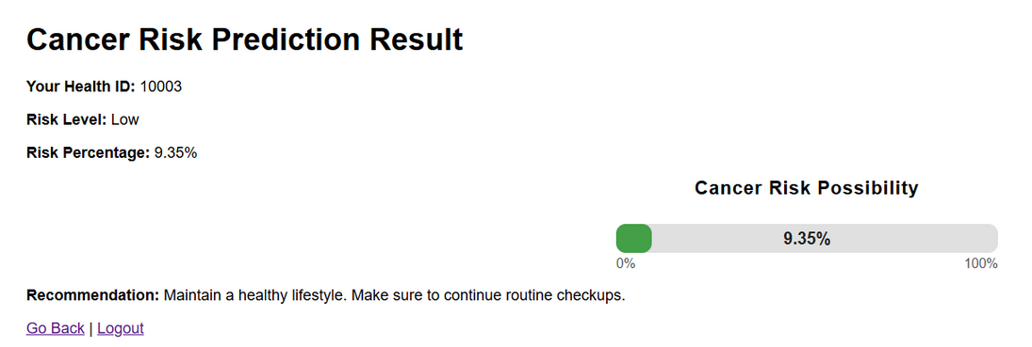
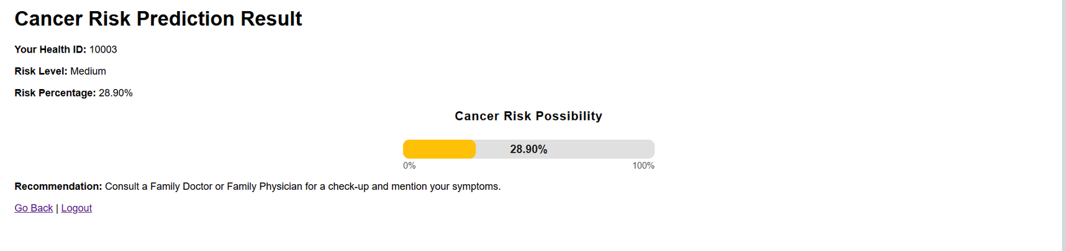
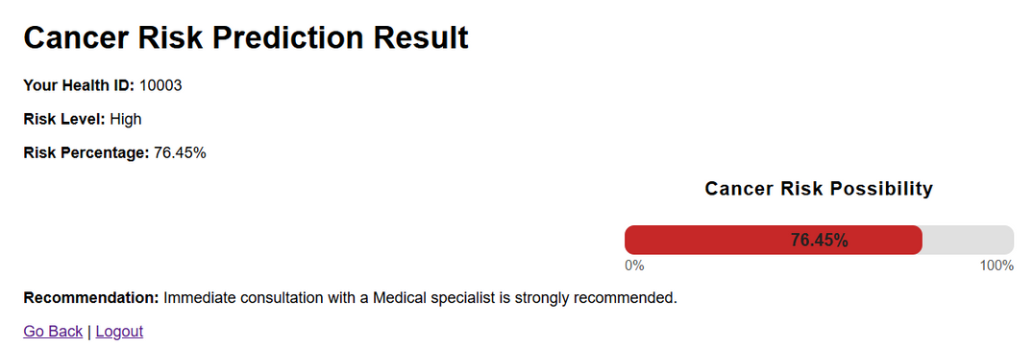
Risk Assessment
Understanding Your Cancer Risk Percentage
This section evaluates the likelihood of cancer based on the symptoms entered by the user. The system analyzes the data using predictive algorithms and categorizes the risk level

Slide 9

Tailored Recommendations
This section outlines personalized recommendations based on the user's risk assessment results. It emphasizes actionable steps individuals can take, such as lifestyle modifications, screenings, and consultations, to mitigate their cancer risk effectively while promoting proactive health management.

Slide 10
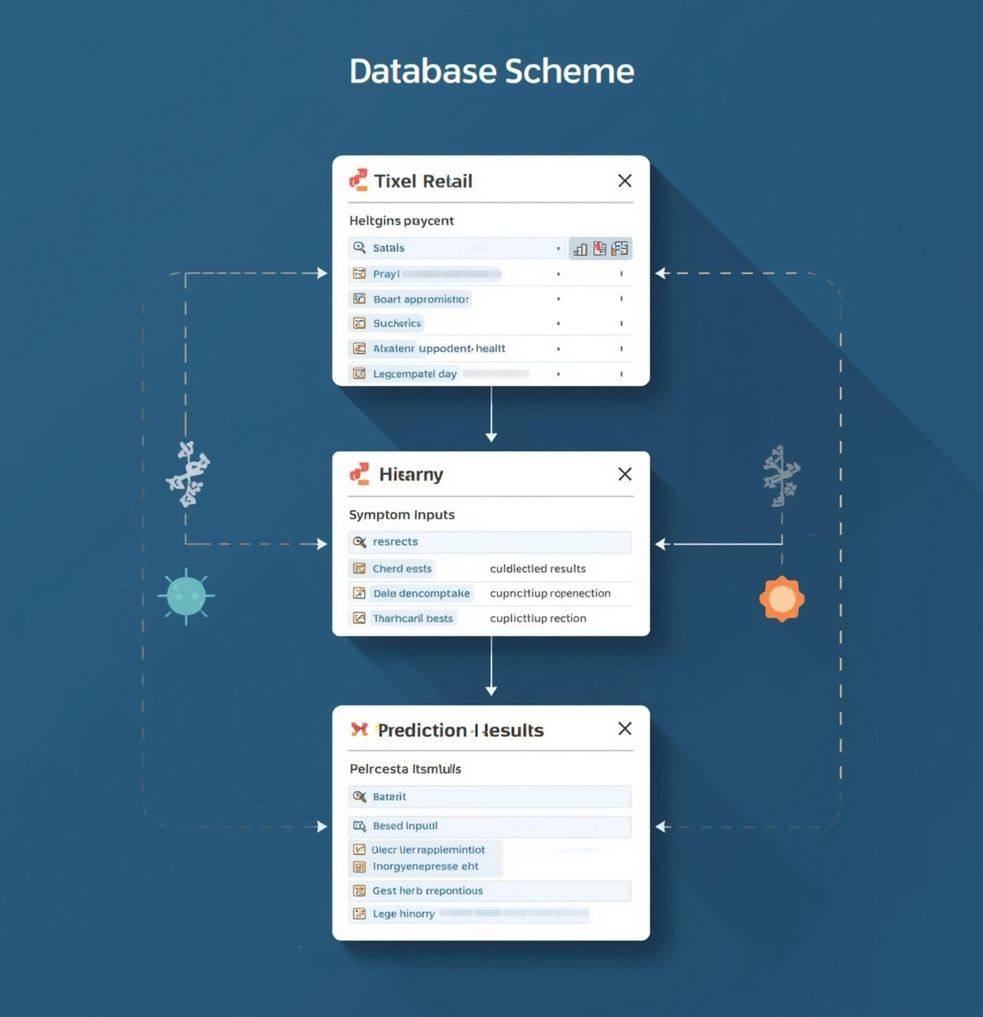
Database Management
This section delves into the organization and storage of prediction results within the Cancer Risk Predictor system. It outlines the database schema, emphasizing user details, symptom inputs, and the critical role of date tracking for longitudinal analysis and analytics.

Slide 11
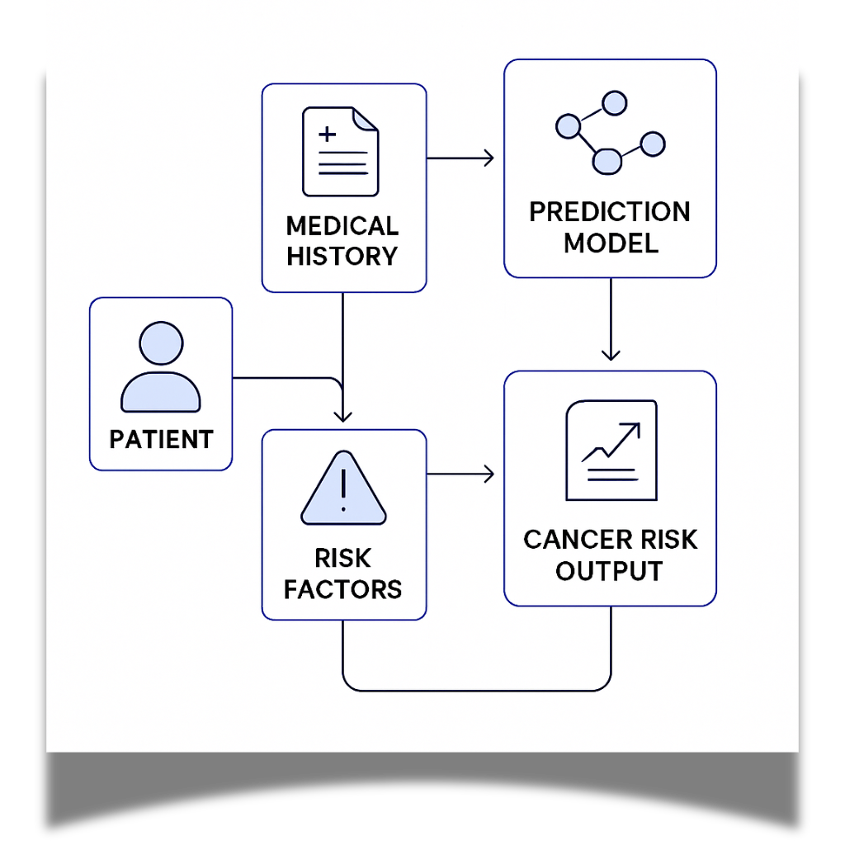
SCHEMA
DIAGRAM

Slide 12

Future Enhancements
The Cancer Risk Predictor project aims to integrate AI capabilities and enhance connectivity with electronic medical records, creating a more personalized user experience. Future developments will focus on leveraging data insights to improve predictive accuracy and support user engagement across platforms.

Slide 13
THANK YOU

